Slide 1
FERMI
PROBLEMS
Solving the impossible…

Slide 2
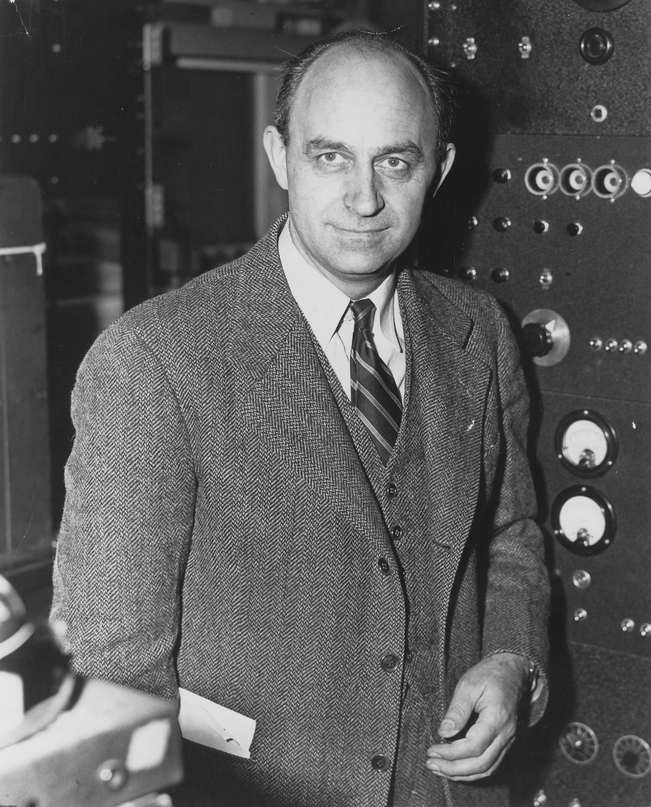
Meet Enrico Fermi (1901-1954)
Enrico Fermi was an Italian-American physicist and creator of the world's first nuclear reactor. In 1938 he received the Nobel Prize in physics for his discovery of nuclear reactions caused by slow neutrons.
Fermi was known for his ability to make good approximate calculations with little or no actual data.
Enrico Fermi Short Documentary
© innovativeteachingideas.com

Slide 3
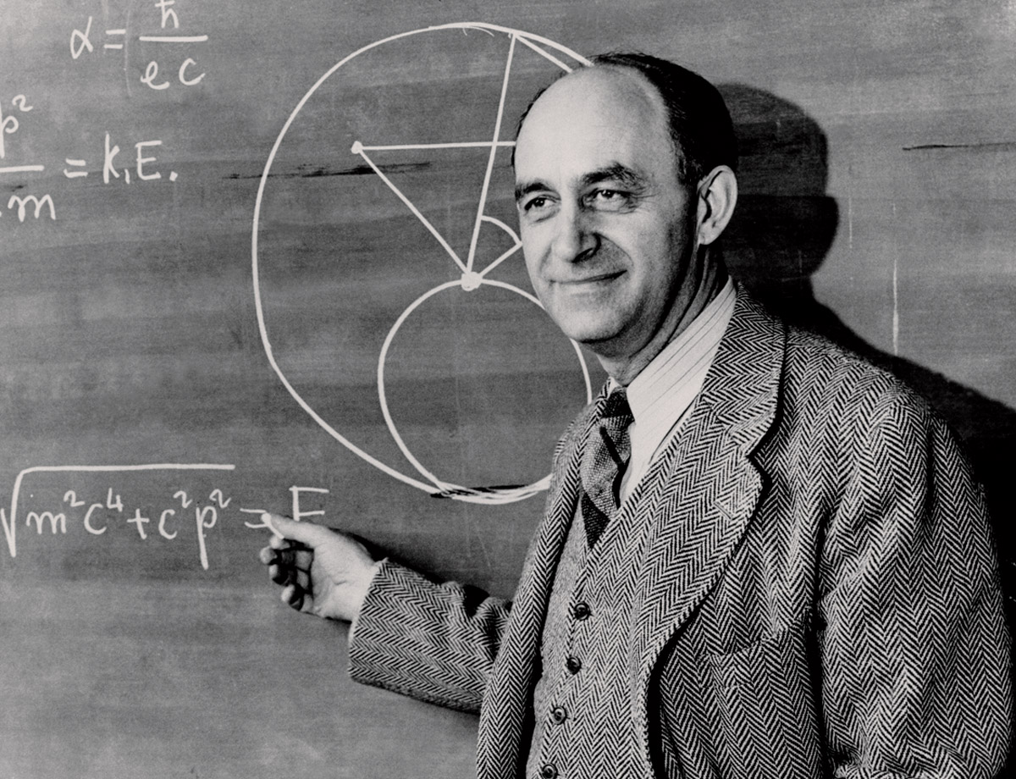
Fermi Questions
A “Fermi Question” is a question that asks for a quick estimate of a quantity that seems difficult or impossible to determine precisely.
For example, the question "How many drops of water are there in Lake Erie?" requires an estimate of the volume of a drop, the volume of Lake Erie from its approximate dimensions and conversion of units to yield an answer.
Fermi’s approach to such questions was to use common sense and rough estimates of quantities to piece together a ball-park value.
© innovativeteachingideas.com

Slide 4

Fermi Problems
How far could you walk in one year?
How many piano tuners are there in Canada?
How many pounds of cheese were eaten in France last year?
How long would it take to count to 1,000,000?
© innovativeteachingideas.com

Slide 5

Skills Needed to Solve Fermi Questions
Many of the skills that you have learned in your math classes will help you solve Fermi Questions:
Modeling
Estimation
Measurement
Algebraic Expressions
Formulas
Problem Solving
Critical Thinking!
© innovativeteachingideas.com

Slide 6

What is Critical Thinking?
Critical thinking is the ability to analyze information objectively and make a reasoned judgement. It involves the evaluation of sources, such as data, facts, observable phenomena and research findings. (source)
Fermi Problems are BIG questions that can seem impossible to answer. You must think critically and creatively to come up with estimates. The goal is not always to get an exact answer!
© innovativeteachingideas.com

Slide 7
Goals for Fermi Questions
When solving Fermi Questions, our focus will be on process - not the final outcome. We hope to:
Generate many potential solutions to a given problem
Analyze problems for different points of view
Make decisions as a part of a group
Communicate mathematical ideas verbally and in writing
Create and utilize formulas to tackle a problem
Use internet search tools to find information
Hone estimation skills and confidence
Remember: The goal is not always to get an exact answer!
© innovativeteachingideas.com

Slide 8

5 Steps for Answering Fermi Questions
Question
Wild Guess
Educated Guess
Gathering Data
Conclusion
© innovativeteachingideas.com

Slide 9

Step 1: Question
State the question and clarify the interpretation.
© innovativeteachingideas.com

Slide 10

Step 2: Wild Guess
Make a wild guess involving no calculations.
© innovativeteachingideas.com

Slide 11

Step 3: Educated Guess
Make an educated guess involving a chain of reasoning and calculations based on everyday experiences and estimates.
© innovativeteachingideas.com

Slide 12

Step 4: Gathering Data
Perform experiments, conduct surveys, make measurements or search for information that would help you obtain a more precise estimate. If appropriate, define variables and create a formula to solve the Fermi question.
© innovativeteachingideas.com

Slide 13
Step 5: Conclusions
State your final answer to the question. Explain some possible sources of error in your procedure. List any interesting facts you learned while seeking the answer to the Fermi question. Finally, discuss further direction that you could pursue if you wanted to extend your investigation into this topic.
© innovativeteachingideas.com

Slide 14
How many times could you say the alphabet in 24 hours?
GUIDED EXAMPLE 1:
© innovativeteachingideas.com

Slide 15
Step 1: Question
State the questions and clarify the interpretation.
We are being asked to find how many times a person could say the alphabet in 24 hours. We are interpreting this to mean; how many times could a person say the alphabet in 24 hours without stopping for any reason (for example to take a nap or go to the bathroom). We are only counting the time it takes for the person to recite the alphabet and not any other parts of the song (“now I know my ABC’s, next time won’t you sing with me”).
© innovativeteachingideas.com

Slide 16
Step 2: Wild Guess
Make a wild guess involving no calculations.
Guess some numbers that are probably less than the real number and some that are probably more. Guess some that are close to the right answer.
How many times do you think you could recite the alphabet in 24 hours? 300 times? 3,000 times? 3,000,000 times?
Record your guesses on your worksheet.
© innovativeteachingideas.com

Slide 17
Step 3: Educated Guess
Make an educated guess using a chain of logic to come up with an estimate. List some questions you would need to answer to figure out the Fermi Problem.
Some questions we may need to answer:
How many seconds are in 24 hours?
How long does it take to recite the alphabet?
Estimate using logic:
There are 26 letters in the alphabet. Assuming it takes me a second to say each letter, it would take me 26 seconds to say the alphabet.
At this rate I could roughly say the alphabet about 138 times in an hour. 138 x 24 = 3,312.
© innovativeteachingideas.com

Slide 18
Step 4: Gathering Data
Perform experiments, conduct surveys and make measurements. If appropriate, create and use formulas.
There are 26 letters in the alphabet
It takes 13.6 seconds to recite the alphabet (you may want to perform your own experiment, or some research on Google)
There are 60 seconds in 1 minute, 60 minutes in 1 hour
There are 24 hours in one day
There are 3,600 seconds in 1 hour, 86, 400 seconds in 1 day
86,400
= 6,352.94
13.6
© innovativeteachingideas.com

Slide 19
Step 4: Gathering Data, continued (optional)
Perform experiments, conduct surveys and make measurements. If appropriate, create and use formulas.
You may want to define variables and create a formula to help you solve this Fermi problem.
Let T represent the total time it takes (in seconds) to recite the alphabet and let x represent the numbers of repetitions. Th formula: T = 13.6x can help us calculate the time it will take (in seconds) to recite the alphabet a certain number of times.
86,400 = 13.6x
13.6
13.6
x=6,352.94
© innovativeteachingideas.com

Slide 20
Step 6: Conclusion
State your final answer. Discuss possible sources of error, interesting facts learned and possible extensions.
Based on this analysis, we conclude that we can say the alphabet 6,352 times in 24 hours.
It takes 13.6 seconds to say the alphabet. Given that there are 86,400 seconds in 24 hour, one could recite the alphabet 6,352 times in that time frame.
One possible source of error is that we did not account for any breaks or mistakes. This might be unrealistic if attempted in real life.
One interesting fact I learned is that there are about 100 languages that use an alphabet similar to English. While some languages have a few more and others a few less, they all share the core 23 letters originally found in the Roman alphabet. It would be interesting to compare the number of times one could recite the alphabet in different languages given the same time frame.
© innovativeteachingideas.com

Slide 21
Estimate the number of cars in the USA that will have an oil change next Tuesday.
GUIDED EXAMPLE 2:
© innovativeteachingideas.com

Slide 22
Step 1: Question
State the questions and clarify the interpretation.
We are being asked to estimate the number of cars in the USA that will have an oil change performed on their car next Tuesday. We are interpreting car in this scenario to only refer to those driven by the general public (cars, sport utility vehicles, vans, etc.) and not semi-trucks used to transport mass quantities of goods. We are interpreting the USA as all 50 states including Hawaii and Alaska.
© innovativeteachingideas.com

Slide 23
Step 2: Wild Guess
Make a wild guess involving no calculations.
Guess some numbers that are probably less than the real number and some that are probably more. Guess some that are close to the right answer.
How oil changes do you think you think will take place next Tuesday? 500? 5,000? 50,000,000?
Record your guesses on your worksheet.
© innovativeteachingideas.com

Slide 24
Step 3: Educated Guess
Make an educated guess using a chain of logic to come up with an estimate. List some questions you would need to answer to figure out the Fermi Problem.
Some questions we may need to answer:
How many cars are there in the USA?
How often do cars need oil changes?
How many miles do cars drive per year on average?
Estimate using logic:
There are about 300 million people in the USA. Estimating that about half of them have cars, we can guess that there are about 150 million cars in the USA.
If each of those cars gets at least 2 oil changes per year, thats 300 million oil changes. Tuesday is 1 out of 7 possible days in a week. 300 million divided by 7 is about 42 million.
© innovativeteachingideas.com

Slide 25
Step 4: Gathering Data
Perform experiments, conduct surveys and make measurements. If appropriate, create and use formulas.
There are 263.6 million cars in the USA (Google)
On average, cars in the USA drive 13, 476 mi (21687.51 km) per year
On average, cars need an oil change every 3,000 miles (4828 km). Thus, cars need about 4 oil changes per year.
236.6 million cars receiving 4 oil changes per year works out to roughly 946.4 million oil changes per year.
There are 365 days in a year
946,400,000
= 2,592,876.7 oil changes per day
365
© innovativeteachingideas.com

Slide 26
Step 6: Conclusion
State your final answer. Discuss possible sources of error, interesting facts learned and possible extensions.
Based on this analysis, we conclude that there will be about 2.5 million oil changes performed in the USA next Tuesday. I calculated that there are about 9.4 million oil changes performed in the USA every year. Dividing that number by the number of days in a year gave me the number of oil changes performed every day, which includes Tuesdays.
An interesting fact I learned is that teenagers in the USA are eligible to get their permit at 14 years and 9 months of age. That seems really young to me! I also learned that newer cars can go longer between oil changes (~5-7,000 miles instead of 3,000).
On possible source of error is that we did not account for holidays or other days on which oil changes may not be performed (for example Christmas or mechanic shops closed on Sundays). We all made a general assumption that all cars get 4 oil changes per year. Some people may drive less and require fewer oil changes.
It would be interesting to calculate the total revenue generated by the number of oil changes that will take place next Tuesday.
© innovativeteachingideas.com

Slide 27
Your Turn!
FERMILAB
© innovativeteachingideas.com

Slide 28

FERMILAB OVERVIEW
Individually or with a partner, you will create your own Fermi Problem and find the solution. You will be graded on the following elements:
Creativity
Process
Conclusion
© innovativeteachingideas.com

Slide 29
Characteristics of a Good Fermi Problem
A good Fermi Problem is/has...
Open ended and can’t be answered with a simple yes or no.
Creative and requires critical thinking
No exact answer or definite solution
Multiple ways to solve/arrive at a solution
Most importantly, your Fermi Problems should be something that you actually are interested in learning about!
Be creative! Think outside the box…
© innovativeteachingideas.com

Slide 30
Sample Fermi Problems
What is the total number of shots taken in one NBA season?
How many steps does a dancer take during a song?
How many hours will you spend on Facebook in a lifetime?
How many pizzas were eaten last year in Chicago?
How many drops of water are there in the Atlantic Ocean?
© innovativeteachingideas.com

Slide 31
5 Steps for Answering Fermi Questions
Question: State the question and clarify the interpretation.
Wild Guess: Make a wild guess involving no calculations.
Educated Guess: Make an educated guess involving a chain of reasoning and calculations based on everyday experiences and estimates.
Gathering Data: Perform experiments, conduct surveys, make measurements or search for information that would help you obtain a more precise estimate. If appropriate, define variables and create a formula to solve the Fermi question.
Conclusions: State your final answer to the question. Explain some possible sources of error in your procedure. List any interesting facts you learned while seeking the answer to the Fermi question. Finally, discuss further direction that you could pursue if you wanted to extend your investigation into this topic.
© innovativeteachingideas.com

